Slide 1

Introduction to Computer Science: Programming Methodology
Tutorial 7
list

Slide 2
Self Introduction
Name: Wu Ruixiang
Major: Data Science and Big Data Technology
Email: ruixiangwu@link.cuhk.edu.cn
Office Hour: By appointment

Slide 3
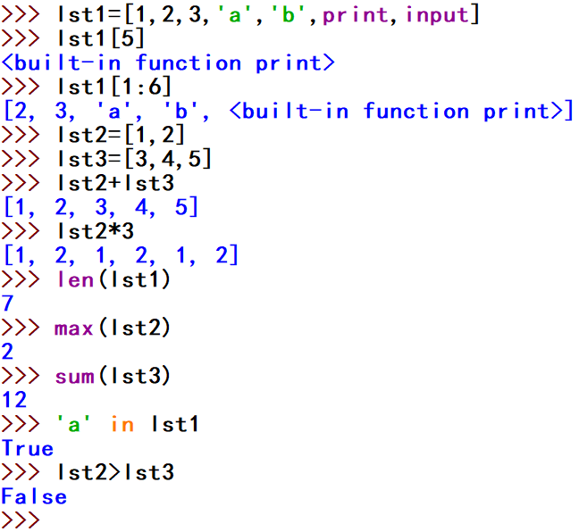
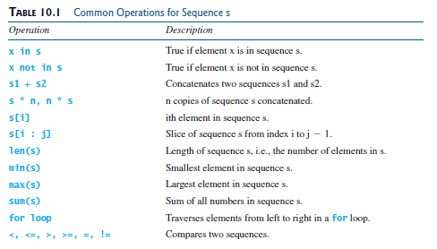
1.List is a Sequence
Similar to strings, lists are sequences; lists are sequences of some elements, which can be any objects.

Slide 4
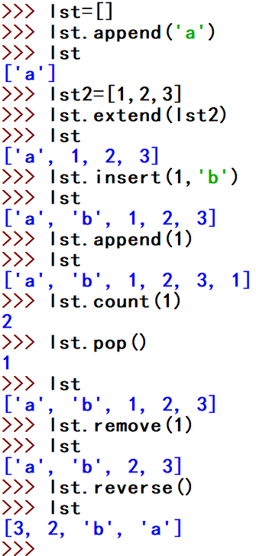
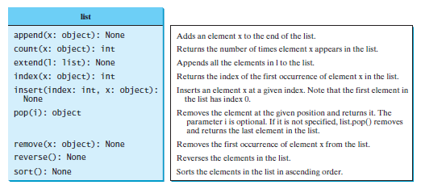
2.Methods of List

Slide 5
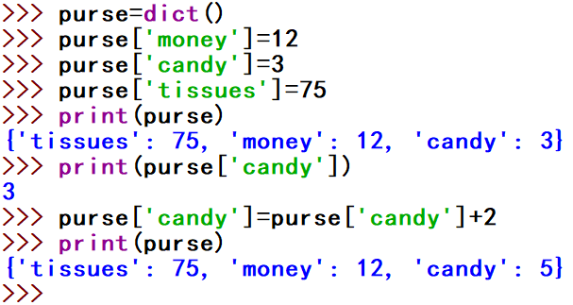
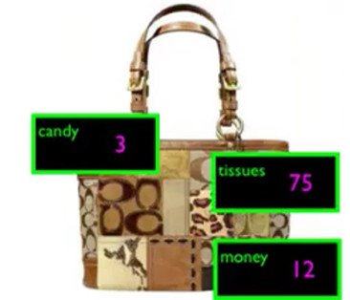
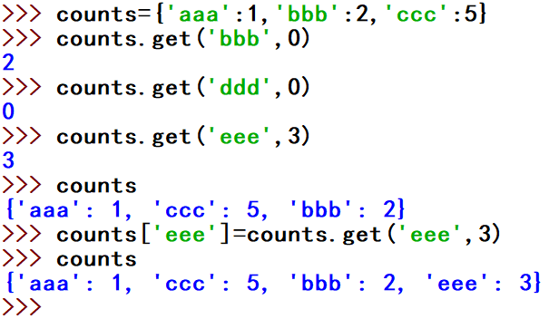
3.Dictionary
Dictionary
The get() method
This pattern of checking to see if a key is already in a dictionary, and assuming a default value if the key is not there is so common, that there is a method called get() that does this for us.
1.Dictionary labels each element with its key.
2.Elements in a dictionary have no order.

Slide 6
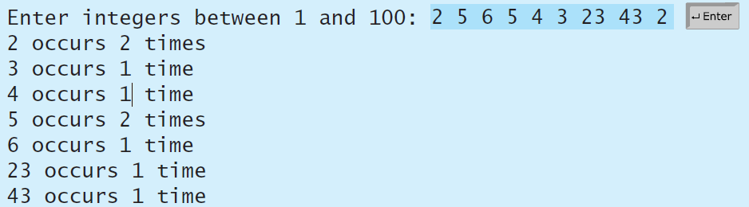
Q1: Count occurences
Write a program that reads some integers between 1 and 100 and counts the occurrences of each.
Note that if a number occurs more than one time, the plural word “times” is used in the output.

Slide 7
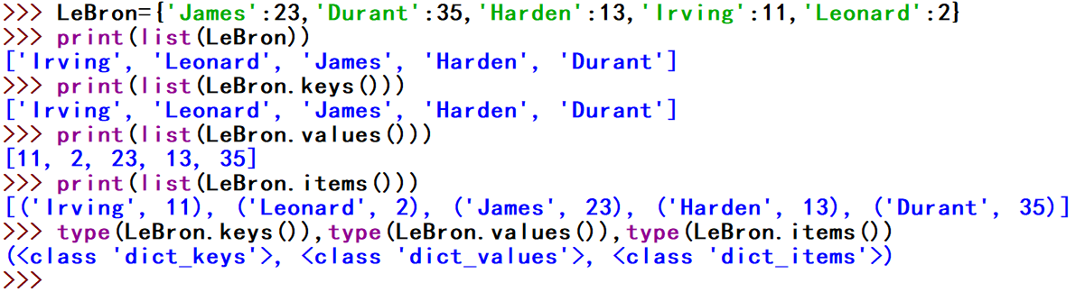
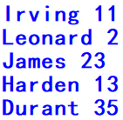
4.Retrieving keys and values
You can get a list of keys, values or items(both) from a dictionary.
Bonus: two iteration variables.

Slide 8
Q2: Display distinct numbers
Write a program that reads in numbers separated by a space in one line and displays distinct numbers (i.e., if a number appears multiple times, it is displayed only once).
Hint: Read all the numbers and store them in list1. Create a new list list2. Add a number in list1 and list2. If the number is already in the list, ignore it.
Here is the sample run of the program:

Slide 9
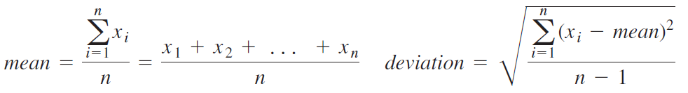
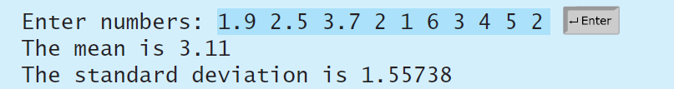
Q3: Compute mean and deviation
Compute the standard deviation of n numbers:
Your program should contain the following functions: def deviation(x): and def mean(x):. Write a test program that prompts the user to enter a list of numbers and displays the mean and standard deviation, as shown in the following sample run:

Slide 10
Q4: Test sorted list
Write the following function that return True if the list is already sorted in increasing order: def isSorted(lst): .Write a test program that prompts the user to enter a list and displays whether the list is sorted or not. Here is a sample run:

Slide 11
Q5: Word recitation
The file Dictionary.txt stores some words along with their meanings in English, using colon “:” to separate. Write a program to randomly select an English word from the file and allow users to guess it by looking at the description of it on the screen. The program will give you feedback whether your guess is correct or not. If wrong, it will tell you the correct answer. Words in the file won’t appear twice and after finishing guessing all words in the file, the program will tell you how many words you guess correctly.

